Slide 1
Day - 2
Created By AMITAVA CHATTERJEE
HTM JavaScript - Day-2

Slide 2
Objectives
Using Special Characters
Style Sheet
  Purpose of Style Sheet
  Style Rules
  Attaching Style Sheet
  Defining classes
  Div tag, Span Tag
  Using Span
Developing Forms
  Introducing Forms
  Using Standard Form Controls
HTM JavaScript - Day-2

Slide 3
Special Characters in HTML
Character | Entity | Decimal | Hex | Rendering in the Browser
Less-than sign | &lt; | &#60; | &#x3C; | <
Greater-than sign | &gt; | &#62; | &#x3E; | >
Quotation mark | &quot; | &#34; | &#x22; | "
left double quotation mark | &ldquo; | &#8220; | &#x201C; | “
right double quotation | &rdquo; | &#8221; | &#x201D; | ”
Euro sign | &euro; | &#8364; | &#x20AC; | €
HTM JavaScript - Day-2
Notes:
For special characters refer to - http://htmlhelp.com/reference/html40/entities/special.html

Slide 4
Text Formatting (Contd.)
Special Characters
Example
<html>
<body>
<h2><b>&lt;MARQUEE&gt;</b> is used to scroll the enclosing text.</h2>
</body>
</html>
HTM JavaScript - Day-2

Slide 5
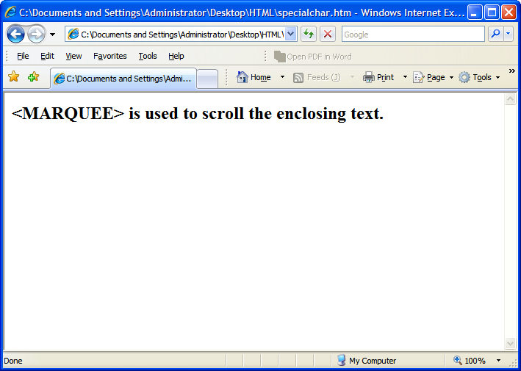
Text Formatting (Contd.)
Special Characters
Output
HTM JavaScript - Day-2

Slide 6
Web
StyleSheets
HTM JavaScript - Day-2

Slide 7
Cascading Style Sheet
Web style sheets are a form of separation of presentation and content for web design .
Style sheet can decide the presentation of web pages.
Style sheet takes care of all the layout, fonts, colors and overall look of the site.
HTM JavaScript - Day-2
Notes:
HTML was originally designed as a simple way of presenting information, with the aesthetics of a web page being far less important than the content (and largely being left up to the web browser). Of course, now that the web has become as popular as it has, the presentation of your content has become almost critical to a site’s success. This, among other things, was why CSS was brought in.

Slide 8

Cascading Style Sheet (contd..)
Principal means of Styling a document using Cascading style sheets are:
Inline style Sheet
Embedded style Sheet
External style Sheet
HTM JavaScript - Day-2
Notes:
One can use another mechacanisim of styling documents by using Inline Style sheets
An inline style loses many of the advantages of style sheets by mixing content with presentation. Use this method sparingly, such as when a style is to be applied to a single occurrence of an element.
To use inline styles you use the style attribute in the relevant tag. The style attribute can contain any CSS property. The example shows how to change the color and the left margin of a paragraph:
<p style="color: sienna; margin-left: 20px"> This is a paragraph </p>

Slide 9
Benefits of a Cascading Style Sheet
Pages download faster.
Page contains less code, and the pages are shorter and neater.
The look of the site is kept consistent throughout all the pages that work off the same stylesheet.
Updating the design and general site maintenance are made much easier.
HTM JavaScript - Day-2
Notes:
Well-authored CSS also improves the accessibility of web content, allowing access through myriad devices (handheld PDAs for example) and ensuring that web users with disabilities are still able to receive it. It also eliminates the need for browser-specific hacks and tags, which means your site has a better chance of working across all major browsers.
Initially vaguely intimidating, CSS is a well-designed, elegant language. It is hugely important for the future of web design, and has been pivotal in helping designers move away from the problematic, hack-ridden days of presentational HTML tags like <font>, and allowed us to return to using logical, structural elements which make our sites more accessible.
All that, and there are dozens of powerful extra formatting options and possibilities available through stylesheet commands that are not possible through normal HTML. You’ll see these later on when we get on to things like backgrounds, spacing, layers and borders.

Slide 10

Parts of a Cascading Style Sheet
CSS syntax is made up of three parts:
HTML tag that you wish to change
Selector
The attribute that you wish to change
Property
Each property can take a value
Value
HTM JavaScript - Day-2

Slide 11
Categories of Style Sheet Properties
Font Properties
Color and Background Properties
Cursor Properties
Text Properties
Border Properties
List Properties
Margin Properties
Padding Properties
Aural Properties
HTM JavaScript - Day-2
Notes:
To refer to a list of Stylesheet properties you can refer to : http://www.pageresource.com/dhtml/cssprops.htm
Table Properties
PropertyDescriptionPossible ValuesExamplesborder-collapseDeclares the way borders are displayed. collapse
separate table { border-collapse:collapse; } table { border-collapse:separate; }
border-spacingDeclares the distance separating borders (if border-collapse is separate). Lengths for the horizontal and vertical spacing, separated by a space. If one length is value is declared, that length is used for both the horizontal and vertical spacing. If two lengths are declared, the first one is used for horizontal spacing and the second one is used for vertical spacing.
table { border-spacing:5px; } table { border-spacing:5px 10px; }
caption-side Declares where the table caption is displayed in relation to the table. top
bottom
left
right caption { caption-side:top; } caption { caption-side:right; }
empty-cellsDeclares the way empty cells are displayed (if border-collapse is separate). show
hide table { empty-cells:show; } table { empty-cells:hide; }
table-layoutDeclares the type of table layout. auto
fixed table { table-layout:auto; }

Slide 12
Categories of Style Sheet Properties – Font Properties
Font Properties – Some of the attributes with their possible values are as follows:
  Font-family : Arial,Times New Roman, Serif
  Font-size : number of pixels, percentage (Ex- <div style=“font-size:45px”>The font is of 45 pixels</div>)
  Font-style : normal|italic|oblique
  Font-variant : normal|small-caps
  Font-weight :normal|bold|bolder|lighter|100-900
HTM JavaScript - Day-2
Notes:
When a document's text is to be displayed visually, characters (abstract information elements) must be mapped to abstract glyphs. One or more characters may be depicted by one or more abstract glyphs, in a possibly context-dependent fashion. A glyph is the actual artistic representation of an abstract glyph, in some typographic style, in the form of outlines or bitmaps that may be drawn on the screen or paper. A font is a set of glyphs, all observing the same basic motif according to design, size, appearance, and other attributes associated with the entire set, and a mapping from characters to abstract glyphs.
CSS2 specifies fonts according to these characteristics:
Font family
The font family specifies which font family is to be used to render the text. A font family is a group of fonts,designed to be used in combination and exhibiting similarities in design. One member of the family may be italic, another bold, another condensed or using small caps. Font family names include "Helvetica", "New Century Schoolbook", and "Kyokasho ICA L". Font family names are not restricted to Latin characters. Font families may be grouped into different categories: those with or without serifs, those whose characters are or are not proportionally spaced, those that resemble handwriting, those that are fantasy fonts, etc.
Font style
The font style specifies whether the text is to be rendered using a normal, italic, or oblique face. Italic is a more cursive companion face to the normal face, but not so cursive as to make it a script face. Oblique is a slanted form of the normal face, and is more commonly used as a companion face to sans-serif. This definition avoids having to label slightly slanted normal faces as oblique, or normal Greek faces as italic.
Font variant
The font variant indicates whether the text is to be rendered using the normal glyphs for lowercase characters or using small-caps glyphs for lowercase characters. A particular font may contain only normal, only small-caps, or both types of glyph; this property is used to request an appropriate font and, if the font contains both variants, the appropriate glyphs.
Font weight
The font weight refers to the boldness or lightness of the glyphs used to render the text, relative to other fonts in the same font family.
Font stretch
The font stretch indicates the desired amount of condensing or expansion in the glyphs used to render the text, relative to other fonts in the same font family.
Font size
The font size refers to the size of the font from baseline to baseline, when set solid (in CSS terms, this is when the 'font-size' and 'line-height' properties have the same value).

Slide 13
Categories of Style Sheet Properties – Color and Background Properties
Color and Background Properties – Some of the attributes with their possible values are as follows:
  color : Any possible colors (Used to set Foreground color)
  Background-color : Allows to add a background behind most anything.
  Background-image : Sets the background image.
  For Example, <TABLE style="background-image:url(http://www.yoursource.com/images/image.jpg)" border="1"> <TD>Wow! I can still read this?</TD></TABLE>
  Background-repeat : repeat, no-repeat, repeat-x, repeat-y.
  Background-attachment : scroll, fixed
  Background-position : top, center, or bottom with left, center, or right
HTM JavaScript - Day-2

Slide 14
Categories of Style Sheet Properties – Cursor Properties
Cursor Properties – Some of the attributes with their possible values are as follows:
  Cursor : type. Possible types are as follows:-
    Default, crosshair, move, hand, help, text, wait, n-resize, s-resize, e-resize, w-resize, ne-resize, nw-resize, se-resize, sw-resize.
HTM JavaScript - Day-2

Slide 15
Categories of Style Sheet Properties – Text Properties
Text Properties – Some of the attributes with their possible values are as follows:
  Letter-spacing : Declares amount of space between text
  Word-spacing : Declares amount of space between two words.
  Direction : ltr, rtl
  Line-height : Declares the distance between the lines.
  characters.
  Text-align : Declares horizontal alignment of inline content.
    Possible values – left, right, center, justify
  Text-decoration : none, underline, overline, line-through, blink.
  Text-indent : Declares indentation of the first line of text.
  Text-transform : none, capitalize, uppercase, lowercase
HTM JavaScript - Day-2

Slide 16
Categories of Style Sheet Properties – Border Properties
Border Properties – Some of the attributes with their possible values are as follows:
  Border-top-color : some color.
  Border-top-style : none, hidden, dotted, dashed, solid, double, groove, ridge, inset, outset.
  Border-top-width : thin, medium, thick, or specify in pixel.
  Border-top : Used as a shorthand to set all the border-top properties at once, i.e. setting the border-top-color, border-top-style, border-top-width.
  Border-<<direction>> : direction refers to left, right, top, bottom.
HTM JavaScript - Day-2

Slide 17
Categories of Style Sheet Properties – List Properties
List Properties – Some of the attributes with their possible values are as follows:
  List-style-type : disc, circle, square, decimal, decimal-leading-zero, lower0roman, upper-roman, lower-alpha, upper-alpha,
  List-style-image : Declares an image to be used as the list marker.
  For Example, ul { list-style-image:url(image.jpg); }
  list-style-position : Declares the position of the list marker. Possible values are : inside, outside.
HTM JavaScript - Day-2

Slide 18
Categories of Style Sheet Properties – Margin Properties
Margin Properties – Some of the attributes with their possible values are as follows:
  Margin-top : Declares the top margin for the element. Possible values – Percentage, Length in pixels. Ex- div { margin-top:5px} div { margin-top:10%}
  Margin-right : Set right margin.
  Margin-bottom : Set bottom margin.
  Margin-left : Set left margin.
  Margin : shortcut for all the above four attributes.
HTM JavaScript - Day-2

Slide 19
Categories of Style Sheet Properties – Padding Properties
Padding Properties – Some of the attributes with their possible values are as follows:
  Padding-top : Declares the top padding for the element. Possible values – Percentage, Length in pixels. Ex- div { padding-top:5px} div { padding-top:10%}
  Padding-right : Set right padding.
  Padding-bottom : Set bottom padding.
  Padding-left : Set left padding.
  Padding : shortcut for all the above four attributes.
HTM JavaScript - Day-2

Slide 20
Inline Style Sheet
Inline style sheets are applied by coding style properties and values inside the tags to which they apply.
An inline style sheet can appear inside any tag to directly set its style. All that is required is to enclose the applicable style properties and values inside a quoted style attribute.
Syntax
  <tag style=“property:value [;property:value]…”>
HTM JavaScript - Day-2

Slide 21
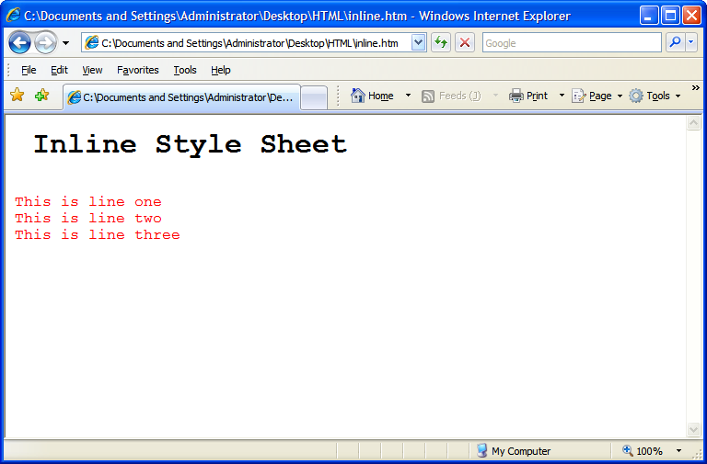
Inline Style Sheet(contd.)
<html>
<body>
<pre>
<h1> Inline Style Sheet</h1>
<p style="font-size: 12pt; color: red">
This is line one
This is line two
This is line three
</p>
</body>
</html>
HTM JavaScript - Day-2

Slide 22
Embedded Style sheet
Embedded style sheets are used when a unique style is required for a document.
Embedded style are defined in the <head> tag section by using the <style> tag
When a large number of style settings are used on a Web page, there is convenience in packaging the settings together in one place as an embedded style sheet, rather than having them scattered as inline style sheets throughout the document.
HTM JavaScript - Day-2

Slide 23
Syntax of Style sheet
selector {property: value}
Example
p {color: green}
If the value consist of more than one word the value has to be embedded within quotes.
p {font-family: “sans-serif”}
If more then one property needs to be defined then the properties need to be separated by semi colon.
p {font-family: “sans-serif” ; color: green}
HTM JavaScript - Day-2

Slide 24
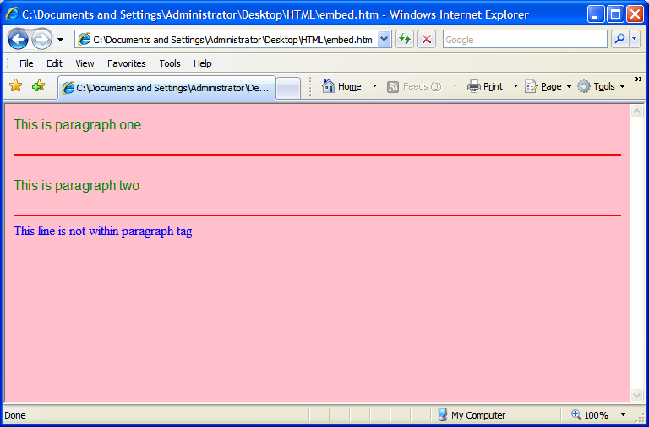
Example of an Embedded Style sheet
<html>
<head>
<style type="text/css">
p {font-family:"sans-serif"; color: green}
hr {color: red}
body {color:blue; background-color:pink}
</style>
</head>
<body>
<p>This is paragraph one</p>
<hr>
<p> This is paragraph two</p>
<hr>
This line is not within paragraph tag
</body>
</html>
HTM JavaScript - Day-2

Slide 25
External Style Sheet
Internal style sheets are used when a common style is required for a set of similar documents.
External style are defined in the <head> tag section by using the <style> tag
The different selectors, their properties and values should be defined within the external style sheet.
The external style sheet should be saved within a file, with an extension of .css
HTM JavaScript - Day-2

Slide 26



External Style sheet
Background is defined
Paragraph font color is
defined
Horizontal color is defined
Requires the background,
Paragraph and horizontal
Rule setting defined
In Mystyle.css
Both the html files uses
<link rel="stylesheet" type="text/css" href=“Mystyle.css" />
FirstPage.html
Requires the background,
Paragraph and horizontal
Rule setting defined
In Mystyle.css
Mystyle.css
SecondPage.html
HTM JavaScript - Day-2

Slide 27
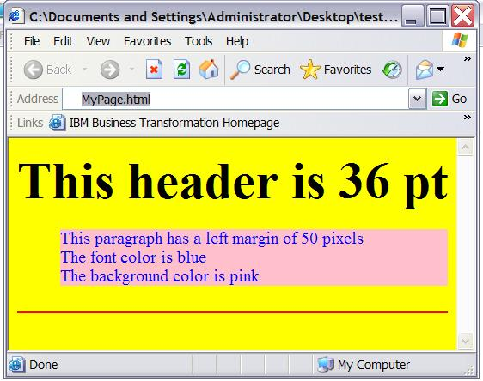
Example of External style sheet
body {background-color: yellow}
h1 {font-size: 36pt}
p {margin-left: 50px; background: pink; color:blue}
hr {color: red}
Mystyle.css
<html>
<head>
<link rel="stylesheet" type="text/css" href="Mystyle.css" />
</head>
<body>
<h1> This header is 36 pt </h1>
<p> This paragraph has a left margin of 50 pixels<br>
The font color is blue<br>
The background color is pink
</p>
<hr>
</body>
</html>
MyPage.html
MyPage.html is using styles
defined in Mystyle.css
HTM JavaScript - Day-2

Slide 28

Multiple Style sheet
<html>
<head>
<link rel=“stylesheet” type=“text/css” href=“Mystyle.css”>
<style type=“text/css”>
h3 {font-size: 20pt}
</style>
</head>
<body>
<h3> This is a header </h3>
---more text----
</body>
</html>
MyPage.html
h3 { color: red;
text-align: left;
font-size: 8pt }
Mystyle.css
Mypage.html Links to
Mystyle.css
The font size of <h3> is redefined here
What will be the Font size
Of <h3>
8pt or 20 pt??
HTM JavaScript - Day-2

Slide 29
Multiple Style sheet Continued
        If some properties have been set for the same selector in different style sheets, the values will be inherited from the more specific style sheet .
The HTML will inherit the
Font color and alingment
From Mystyle.css
<html>
<head>
<link rel=“stylesheet” type=“text/css” href=“Mystyle.css”>
<style type=“text/css”>
h3 {font-size: 20pt}
</style>
</head>
<body>
<h3> This is a header </h3>
---more text----
</body>
</html>
MyPage.html
Font Size will be Inherited
From the Internal Style sheet
h3 { color: red;
text-align: left;
font-size: 8pt }
Mystyle.css
Color: Red
Text-align-left
Font-size- 20pt
HTM JavaScript - Day-2

Slide 30
Some common selectors and attributes
Selector | property
H1,H2,H3….. | font-size,Font-family,font-style , font-weight Color, margin
P | font-size,Font-family,font-style , font-weight Color, Background-color,text-align, margin
HR | color
body | Background-color, font-size,Font-family,font-style , font-weight, margin
HTM JavaScript - Day-2
Notes:
font-family: sans-serif/courier/times
Font-size: 20pt
Font-style: italuc/bold//regular
Font-weight: (sets the boldness of the font)
Font-weight : 900
The CSS margin properties define the space around elements. It is possible to use negative values to overlap content. The top, right, bottom, and left margin can be changed independently using separate properties. A shorthand margin property can also be used to change all of the margins at once.

Slide 31
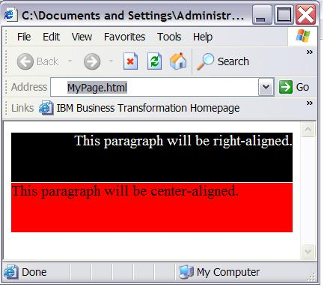
Class Selector
With the class selector you can define different styles for the same type of HTML element.
<html>
<head>
<link rel=“stylesheet” type=“text/css” href=“Mystyle.css”>
</head>
<body>
<p class=“one”>This paragraph is Right aligned </p>
<p class=“two”>This paragraph is Left aligned</p>
</body>
</html>
MyPage.html
p.one {text-align: right; color: white;
background-color: black}
p.two {text-align: left; color: black;
background-color: Red}
Mystyle.css
HTM JavaScript - Day-2

Slide 32
Uses of <DIV> Tag
1. <DIV> tag is a container for other tags.
2. DIV elements are block elements and work behind
the scenes grouping other tags together.
Some of the attributes of <DIV> tag are:
-> id
-> width
-> height
-> title
-> style
<DIV> tag
HTM JavaScript - Day-2
Notes:
When HTML first began, web creators only had two choices. A table layout, or frames. The div element provides a 3rd alternative, since a div can contain any/every other type of html element within its beginning and ending tag.
The div tag defines a division or section within an HTML .
span and div are the only elements that carry no innate semantic meaning, besides the logical grouping of the enclosed elements.
div and span differ from each other in one regard. In standard HTML, a div is a block-level element (and so visually isolates a section of a document on the page, in the same way as a paragraph, whereas a span is an inline element (for containing a piece of information inline with the surrounding text).

Slide 33
Uses of <DIV> Tag
<DIV> tag
Example
<div id="menu" align="right">
<a href="">HOME</a> | <a href="">CONTACT</a> | <a href="">ABOUT</a> | <a href="">LINKS</a></div>
<div id="content" align="left" >
<h5>Content Articles</h5>
<p>This paragraph would be your content paragraph with all of your readable material.</p>
<h5 >Content Article Number Two</h5>
<p>Here's another content article right here.</p>
</div>
HTM JavaScript - Day-2

Slide 34
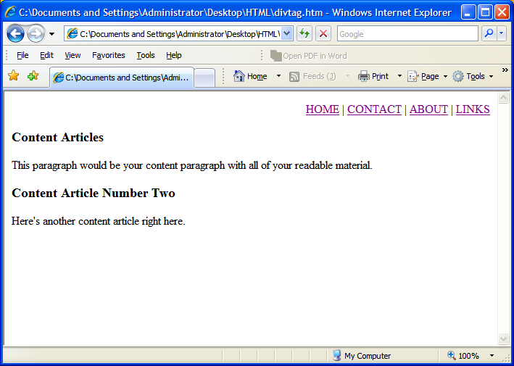
Uses of <DIV> Tag
<DIV> tag
Output
HTM JavaScript - Day-2

Slide 35
Using <span> in CSS
What is the
Utility of <span> in HTML
SPAN is a inline tag.
It is used to format small chunks of data within another element.
Combining <span> tag with CSS allows us to create custom tags.
HTM JavaScript - Day-2
Notes:
Do HTML rules cramp your style? Ever wish you could create your own tag what would behave just like you want? Well you can. Combine the SPAN element with CSS rules to create your own custom tags.
What does SPAN do? Nothing. That's the beauty of it. Since it has no defined display, you're free to write your own rules and apply them as you wish.
SPAN is an inline tag, which means that it's used to format small chunks of text inside another element. In contrast, a paragraph tag is a block-level element that can contain a number of inline elements like bold, italics, strong, and SPAN tags.

Slide 36
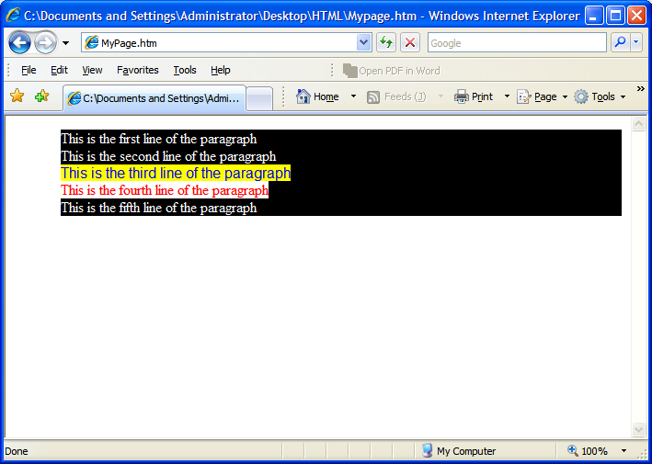
Using <span> in CSS (contd.)
<html>
<head>
<link rel="stylesheet"
type="text/css" href="Mystyle.css" />
</head>
<body>
<p >
This is the first line of the paragraph<br>
This is the second line of the paragraph<br>
<span class="example1">This is the third line of the paragraph<br> </span>
<span class="example2">This is the fourth line of the paragraph<br> </span>
This is the fifth line of the paragraph
</p>
</body>
</html>
MyPage.html
p { color: white ; background-color: black}
.example1 {color:blue ; background-color: yellow ;font-family: "sans-serif"}
.example2 {color:red ; background-color: white ;font-family: times}
Mystyle.css
HTM JavaScript - Day-2

Slide 37
Developing
HTML Forms
HTM JavaScript - Day-2

Slide 38
Form
An HTML form is a section of a document containing normal content, markup, special elements called controls (checkboxes, radio buttons, menus, etc.), and labels on those controls.
Users generally "complete" a form by modifying its controls (entering text, selecting menu items, etc.), before submitting the form to an agent for processing (e.g., to a Web server, to a mail server, etc.)
HTM JavaScript - Day-2

Slide 39
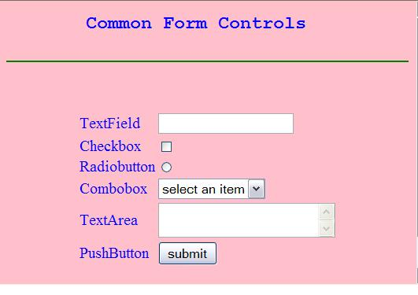
Form (Contd.)
A form is defined with the <form> tag.
HTM JavaScript - Day-2
Notes:
Discuss about the attribute - name, action and method

Slide 40
Form Controls
TextField:
  Are used to accept user input. It is a single line input control.
CheckBox
  Checkboxes are used when you want the user to select one or more options of a limited number of choices.
RadioButton
  Radio Buttons are used when you want the user to select one of a limited number of choices.
Combo Box
  Are used when you want users to choose options from a selectable lists.
TextArea
  Are used to accept user input. TextArea allows entry of multiple lines.
HTM JavaScript - Day-2
Notes:
Checkboxes (and radio buttons) are on/off switches that may be toggled by the user. A switch is "on" when the control element's checked attribute is set. When a form is submitted, only "on" checkbox controls can become successful. Several checkboxes in a form may share the same control name. Thus, for example, checkboxes allow users to select several values for the same property. The INPUT element is used to create a checkbox control.

Slide 41
Form Controls (Contd.)
PushButton
  Each push button may have client side script associated with the element's event attributes. When an event occurs (e.g., the user presses the button, releases it, etc.), the associated script is triggered.
Submit Button
  When activated, a submit button submits a form. A form may contain more than one submit button.
Reset Button
  When activated, a reset button resets all controls to their initial values.
HTM JavaScript - Day-2
Notes:
Use an upload form to allow users to upload pictures, movies, or even their own webpages. An upload form is another type of input form, simply set the type attribute to file.
HTML Code:
<input type="file" />

Slide 42
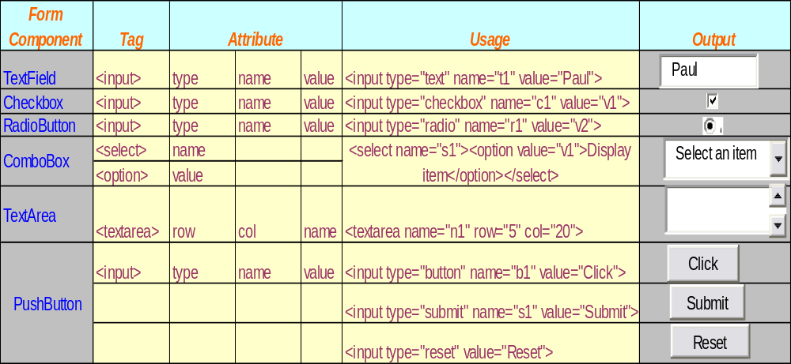
Form Controls (Contd)
HTM JavaScript - Day-2
Notes:
Push button can also be created using <BUTTON></BUTTON> tag.

Slide 43
Example of a Form
<html>
<head>
<title>
Form Example</title>
</head>
<body bgcolor=pink >
<center>
<h3> Data Entry Form</h3>
<form>
<table>
<tr><td>Name</td><td> <input type="text" name="t1"> </td></tr>
<tr><td>Gender</td><td> <input type="radio" name=“r1” value=“m”> Male
<input type="radio" name=“r1” value=“f”>Female</td></tr>
<tr><td>Qualification</td><td><select name=“s”>
<option >Select</option>
<option value=“M.Sc”>M Sc</option>
<option value=“M.A.”>MA</option>
<option value="other">other</option></select>
</td></tr>
<tr><td> <input type="submit" value="submit"> </td>
<td> <input type="reset" value="reset"> </td></tr>
</table>
</center>
</form>
</body>
</html>
HTM JavaScript - Day-2

Slide 44
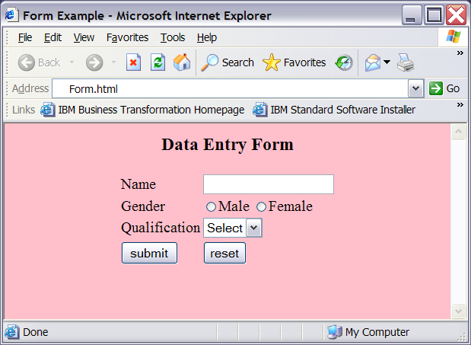
Output of the Form
HTM JavaScript - Day-2

Slide 45
Fieldset & Legend Tag
The fieldset tag is used to group the form elements whilst the legend
tag provides a label for the fieldset.
The HTML legend tag is used for labeling the fieldset element.
By using the fieldset tag and the legend tag, you can make your
forms much easier to understand for your users.
HTM JavaScript - Day-2

Slide 46
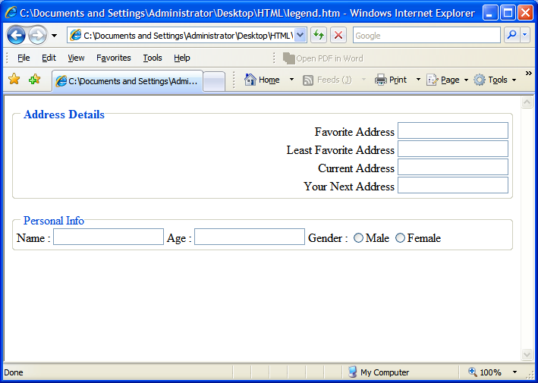
Output Required
HTM JavaScript - Day-2

Slide 47
Code Snippet
<fieldset align="left">
<legend>Personal Info</legend>
Name : <input type="text">
Age : <input type="text">
Gender :
<input type="radio" name="r1">Male
<input type="radio" name="r1">Female
</fieldset>
</body>
</html>
<html>
<body>
<fieldset style="text-align:right;">
<legend><b>Address Details</b></legend>
Favorite Address <input type="text" /><br/>
Least Favorite Address <input type="text" /><br/>
Current Address <input type="text" /><br/>
Your Next Address <input type="text" /><br/>
</fieldset>
<br>
HTM JavaScript - Day-2

Slide 48
<fieldset> tag is used to group the form elements
<fieldset align="left">
<legend>Personal Info</legend>
Name : <input type="text">
Age : <input type="text">
Gender :
<input type="radio" name="r1">Male
<input type="radio" name="r1">Female
</fieldset>
</body>
</html>
<html>
<body>
<fieldset style="text-align:right;">
<legend><b>Address Details</b></legend>
Favorite Address <input type="text" /><br/>
Least Favorite Address <input type="text" /><br/>
Current Address <input type="text" /><br/>
Your Next Address <input type="text" /><br/>
</fieldset>
<br>
HTM JavaScript - Day-2

Slide 49
<legend> tag is used give a suitable label to the group.
<fieldset align="left">
<legend>Personal Info</legend>
Name : <input type="text">
Age : <input type="text">
Gender :
<input type="radio" name="r1">Male
<input type="radio" name="r1">Female
</fieldset>
</body>
</html>
<html>
<body>
<fieldset style="text-align:right;">
<legend><b>Address Details</b></legend>
Favorite Address <input type="text" /><br/>
Least Favorite Address <input type="text" /><br/>
Current Address <input type="text" /><br/>
Your Next Address <input type="text" /><br/>
</fieldset>
<br>
HTM JavaScript - Day-2

Slide 50
Given a Label using legend tag
Created groups using fieldset tag
HTM JavaScript - Day-2

Slide 51
Test Your Understanding (Contd.)
3. The <style> tag should be embedded within:
a. <body>
b. <form>
c. <head>
d. <img>
4. With the _________selector you can define different styles for the same type of HTML element.
Form
Button
Span
class
HTM JavaScript - Day-2

Slide 52
JavaScript
AMITAVA CHATTERJEE
HTM JavaScript - Day-2

Slide 53
Objectives
Day-2 Coverage
Introduction to JavaScript
  Introduction to JavaScript programming language
  Using Script tag
  Inserting Java Script into tags
  Linking Java Script from separate files
JavaScript expression and Operators
  Defining and naming variables
  Data Types
  Expression
  Operators – Arithmetic, String, Logical, Assignment, typeof
HTM JavaScript - Day-2

Slide 54
Objectives (Contd.)
Day-2 Coverage (Continued)
Functions and Flow Control
  Flow Control
    If…else
    For loops
    while loops
    Break and continue statements
  Using JavaScript functions
    Built in functions
    User defined functions
    Returning values from functions
    Events, Event Handlers
HTM JavaScript - Day-2

Slide 55
Objectives (Contd.)
Day–3 Coverage
Objects and Arrays
  Properties and Methods
  Browser Object Hierarchy
  Addressing Objects
  Creating Objects
  Objects and Variables
  External Objects
  Security Implications
  Arrays and Objects
HTM JavaScript - Day-2

Slide 56
Objectives (Contd.)
Day–3 Coverage (Continued)
Document Object Model
  Introduction to DOM
  The Navigator Object
  The Window Object
  Communicating between windows
  Working With Frames in the DOM
  The Document object
  The Location & History Object
  Image Object
  Link Object
HTM JavaScript - Day-2

Slide 57
Objectives (Contd.)
Day–3 Coverage (Continued)
Form Validation The Form Object Model
  Recap of Form Elements
  Form Tag Events
  Controlling Submission
  Forms as Navigation
  List Events
  Buttons
  Text Processing
HTM JavaScript - Day-2

Slide 58
Objectives (Contd.)
Day–3 Coverage (Continued)
Cookies
  Introduction to HTTP Cookies
  Formatting Cookies
  Persisting Cookies
  Cookie Security
  JavaScript & Cookies
  Reading / Writing Cookies
  Modifying and deleting Cookies
HTM JavaScript - Day-2

Slide 59
Introduction to JavaScript (Contd.)
Java is a programming language which requires compilation and interpretation.
Java is used to make large scale applications.
JavaScript is a scripting language which just requires interpretation. The script is some set of commands which the browser interprets.
JavaScript is used to add interactivity in HTML Pages.
Is
JavaScript
same as
Java???
HTM JavaScript - Day-2
Notes:
The two share many similarities. Most prominent of these is that they are both forms of Object-Oriented Programming, or OOP. This means that you work with small objects that are combined together to form larger objects .
Both Java and Java Scripts share similar coding syntaxes.

Slide 60
Types of JavaScript
Client-Side JavaScript (CSJS) -- an extended version of JavaScript that enables the enhancement and manipulation of web pages and client browsers.
Server-Side JavaScript (SSJS) -- an extended version of JavaScript that enables back-end access to databases, file systems, and servers.
Core JavaScript -- the base JavaScript language.
HTM JavaScript - Day-2
Notes:
The Course here deals with CSJS and Core JavaScript

Slide 61
Core JavaScript
Core JavaScript encompasses all of the statements, operators, objects, and functions that make up the basic JavaScript language.
The following objects are part of core JavaScript:
  array
  date
  math
  number
  string
HTM JavaScript - Day-2
Notes:
Originally called LiveScript, JavaScript is a cross-platform, object-oriented scripting language created by Brendan Eich of Netscape.
As you can see, core JavaScript contains objects that are applicable to both client and server. If you know core JavaScript, you can easily write client-side and server-side JavaScript. Again, the only distinction is that client-side and server-side JavaScript have additional objects and functions that you can use that are specific to client-side or server-side functionality. Any JavaScript libraries (.js files) you create in core JavaScript can be used on both the client and the server with no changes whatsoever.

Slide 62
Client Side Java Scripting
CSJS is composed of core JavaScript and many additional objects, such as the following:
  document
  form
  frame
  window
  navigator
HTM JavaScript - Day-2
Notes:
Client-Side JavaScript (CSJS) is the single most popular language on the Internet, used in major web pages which are too numerous to be counted
The objects in CSJS enable you to manipulate HTML documents (checking form fields, submitting forms, creating dynamic pages, and such) and the browser itself (directing the browser to load other HTML pages, display messages, and so on).

Slide 63
Server Side JavaScript
SSJS is composed of core JavaScript and additional objects and functions for accessing databases and file systems, sending e-mail, and so on.
HTM JavaScript - Day-2
Notes:
SSJS enables developers to quickly and easily create database-driven web applications by leveraging their existing knowledge of JavaScript. It's used to create and/or customize server-based applications by scripting the interaction between objects.
SSJS is included with the Netscape Enterprise Server and is ideal for creating web applications that can be run on any platform, on any browser, and in any language. Why create something in Visual Basic or PowerBuilder that can be run on only one platform, when you can create a web application with SSJS that can be run on any existing platform (such as UNIX, Mac, and Windows) and even future platforms (like BEOS)?
SSJS is also available in the Actra line of E-Commerce applications from Netscape, so that customers can customize their applications. The objects employed in the Actra implementation of SSJS are different from those used on the Enterprise Server because the data access engines are different. However, the core language is the same.
For more info
http://www.devarticles.com/c/a/JavaScript/Client-side-and-Server-side-JavaScript/3/

Slide 64
Uses of JavaScript (Client Side)
Menus for Navigation
Form Validation
Popup Windows
Password Protecting
Math Functions
Special effects with document and background
Status bar manipulation
Messages
Mouse Cursor Effects
Links
HTM JavaScript - Day-2

Slide 65
Test Your Understanding
________________ is an extended version of JavaScript that enables the enhancement and manipulation of web pages and client browsers
Client Side JavaScript
Server Side JavaScript
Core JavaScript
HTM JavaScript - Day-2

Slide 66
Test Your Understanding
________________ is an extended version of JavaScript that enables the enhancement and manipulation of web pages and client browsers
Client Side JavaScript
Server Side JavaScript
Core JavaScript
HTM JavaScript - Day-2

Slide 67
Syntax rules of JavaScript
Statements may or may not contain a semicolon at the end.
Multiple statements on one line must be separated by a semicolon.
JavaScript is case sensitive.
HTM JavaScript - Day-2

Slide 68
Using <script> tag
The HTML <script> tag is used to enter JavaScript into a HTML.
The <script> tag can be embedded within
  <head> tag.
  <body> tag.
JavaScript in the head section will be executed when called.
JavaScript in the body section will be executed while the HTML page is loaded.
Unlimited number of JavaScript’s can be placed both in head and body section in a HTML document.
HTM JavaScript - Day-2
Notes:
JavaScripts in a page will be executed immediately while the page loads into the browser. This is not always what we want. Sometimes we want to execute a script when a page loads, other times when a user triggers an event.

Slide 69
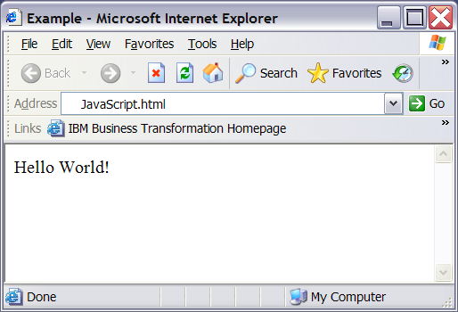
Using <script> tag
Eg:
<html> <head><title>Example</title> </head>
<body>
<script type="text/javascript">
document.write("Hello World!")
</script>
</body>
</html>
Is a standard command for writing output
to a page
HTM JavaScript - Day-2
Notes:
By entering the document.write command between the <script type="text/javascript"> and </script> tags, the browser will recognize it as a JavaScript command and execute the code line. In this case the browser will write Hello World! to the page:
If we had not entered the <script> tag, the browser would have treated the document.write("Hello World!") command as pure text, and just write the entire line on the page.

Slide 70
How to Handle Older Browsers
Browsers that do not support JavaScript will display the script as it is. Use the HTML comment tag to prevent this.
Eg.
<script type="text/javascript">
<!--
document.write("Hello World!")
// -->
</script>
The two forward slashes at the end of comment line (//) are a JavaScript comment symbol. This prevents the JavaScript compiler from compiling the line.
HTM JavaScript - Day-2

Slide 71
Using an External JavaScript
A JavaScript can be written in an external file, which can be used by different HTML pages.
The external script cannot contain the <script> tag.
The external file needs to end with the .js extension.
HTM JavaScript - Day-2

Slide 72
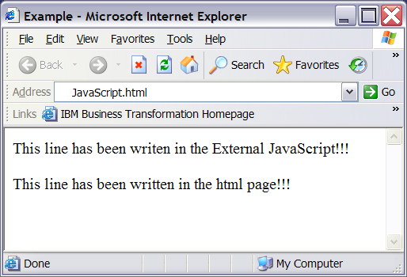
Using External JavaScript (contd.)
<html>
<head><title>Example</title>
</head>
<body>
<script src="External.js">
</script>>
<p >
This line has been written in the
html page!!!
</p>
</body>
</html>
JavaScript.html
document.write("This line has been writen in the External JavaScript!!!")
External.js
HTM JavaScript - Day-2

Slide 73
Test Your Understanding
Select the Correct Statement/s
<script></script> is embedded within
<head> </head>
<script></script is embedded
within <body></body>
<script></script> is embedded within <title></title>
HTM JavaScript - Day-2

Slide 74
Test Your Understanding
Select the Correct Statement/s
<script></script> is embedded within
<head> </head>
<script></script is embedded
within <body></body>
<script></script> is embedded within <title></title>
HTM JavaScript - Day-2

Slide 75
Summary
JavaScript is a scripting Language created by Netscape.
The Three types of JavaScript are:
  Client Side JavaScript.
  Server Side JavaScript.
  Core JavaScript.
Client Side Java Script can be written within an HTML page or as an external Java Script.
Client Side Java Script are integrated into the browsing environment.
Statements in Java Script may or may not contain semicolons.
JavaScript is case sensitive.
The HTML <script> tag is used to enter JavaScript into a HTML.
The <script> tag can be embedded within
  <head> tag.
  <body> tag.
HTM JavaScript - Day-2

Slide 76
JavaScript Operators & Expressions
HTM JavaScript - Day-2

Slide 77
JavaScript Variables and expression
JavaScript Variables
  Variable:
    A variable is a symbolic name that represents some data in the memory.
    A variable value can change during the execution of the JavaScript.
    A variable can be referred by its name to see or change its value.
    Variables are name are case sensitive.
    Must begin with a letter or underscore.
HTM JavaScript - Day-2
Notes:
Variables in Javascript behave the same as variables in most popular programming languages (C, C++, etc) except that you don't have to declare variables before you use them.

Slide 78
Rules of a Variable
Variable Declaration
  Variables can be declared using the var statement
      var <variable name>=some value
  Variables can also be created without using var statement
      <variable name>=some value
      Eg
      var firstname=“Samuel”
      OR
      firstname=“Samuel”
HTM JavaScript - Day-2

Slide 79
Data Type in JavaScript
JavaScript is a loosely typed language.
Loosely Typed??
Data Type of Variable need not be specified during declaration.
Data types are automatically converted during script execution.
HTM JavaScript - Day-2

Slide 80
Data Type in JavaScript (contd.)
JavaScript recognizes the following type of values:
Values
numbers
boolean
9, 3.56
string
true or false
null
Samuel, ”Samuel J Palmisano”
A Special keyword which refers to nothing
HTM JavaScript - Day-2

Slide 81
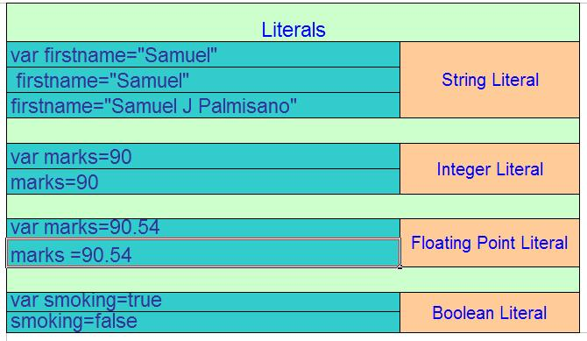
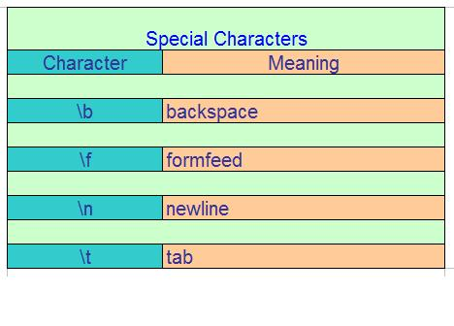
Data Type in JavaScript (contd.)
HTM JavaScript - Day-2
Notes:
You can insert quotation marks inside strings by preceding them with a backslash. This is known as escaping the quotation marks. For example,
var quote = "He read \"The Cremation of Sam McGee\" by R.W. Service."
document.write(quote)
To include a literal backslash inside a string, you must escape the backslash character. For example, to assign the file path c:\temp to a string, use the following:
var home = "c:\\temp"
You can declare a variable as:
var x=“hi”
x=30
The value type can be changed for a variable. Though this is not considered to be good programming.

Slide 82
JavaScript Operators
Operators
Arithmetic
Assignment
Conditional
String
Comparison
typeof
Logical
HTM JavaScript - Day-2

Slide 83
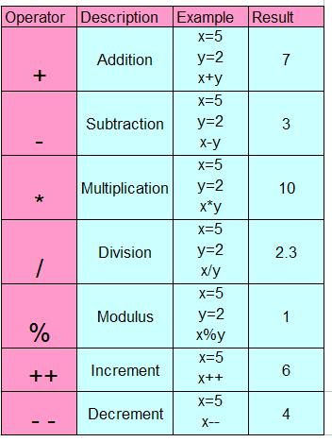
JavaScript Operator (contd.)
Arithmetic
HTM JavaScript - Day-2

Slide 84
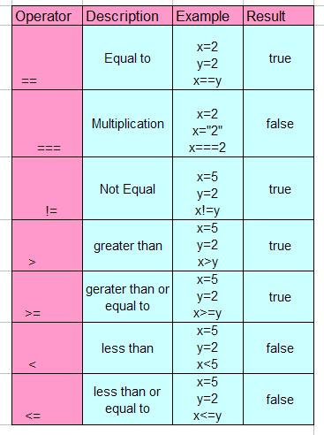
JavaScript Operator (contd.)
Comparison
HTM JavaScript - Day-2

Slide 85
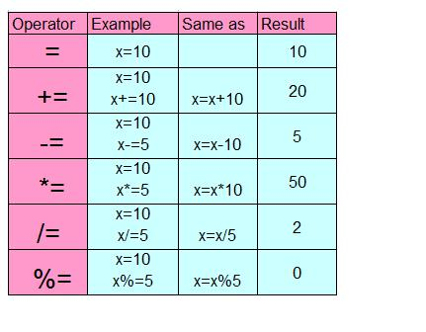
JavaScript Operator (contd.)
Assignment
HTM JavaScript - Day-2

Slide 86
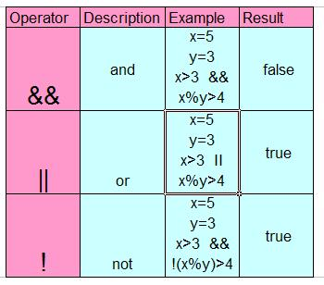
JavaScript Operator (contd.)
Logical
HTM JavaScript - Day-2

Slide 87
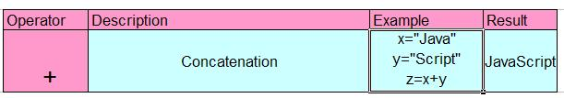
JavaScript Operator (contd.)
String
HTM JavaScript - Day-2

Slide 88
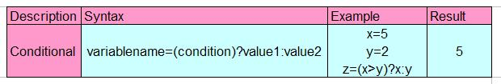
JavaScript Operator (contd.)
Conditional
HTM JavaScript - Day-2

Slide 89
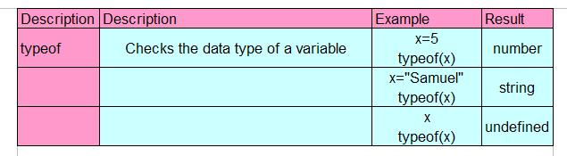
JavaScript Operator (contd.)
typeof
HTM JavaScript - Day-2
Notes:
The "typeof" operator in JavaScript allows you to probe the data type of its operand, such as whether a variable is string, numeric, or even undefined. The below simple example alerts the data type of the variable "myvar"
This special operator is helpful when troubleshooting. It reveals the type of data a variable or literal you are working with is, or the type of data an expression evaluates to. This is important because the type of data you are working with dictates how you are allowed to manipulate that data.
Sometimes you will need to convert a type of data to another type, so it is helpful to be able to test the type of a value or expression at different stages of execution in your script. Used in concert with the alert method, an alert box indicating the data type is generated, helping you trouble shoot a problematic script.

Slide 90
Test Your Understanding
x=20
x=“Test”
typeof(x) evaluates to
number
string
null
HTM JavaScript - Day-2

Slide 91
Test Your Understanding
x=20
x=“Test”
typeof(x) evaluates to
number
string
null
HTM JavaScript - Day-2

Slide 92
Summary
A variable value can change during the execution of the JavaScript.
Variable names are case sensitive.
Must begin with a letter or underscore.
Data Type of Variable need not be specified during declaration.
Data types are automatically converted during script execution.
The values recognized by JavaScript are:
  string
  boolean
  number
  null
HTM JavaScript - Day-2

Slide 93
Summary (contd.)
The different JavaScript operators are
  Arithmetic
  Conditional
  Comparison
  Logical
  Assignment
  Typeof
  Assignment
HTM JavaScript - Day-2

Slide 94
Flow Control
&
Functions
HTM JavaScript - Day-2

Slide 95
Flow Control
Conditional Statements
  if statement - use this statement if you want to execute some code only if a specified condition is true.
  if...else statement - use this statement if you want to execute some code if the condition is true and another code if the condition is false.
  if...else if....else statement - use this statement if you want to select one of many blocks of code to be executed.
  switch statement - use this statement if you want to select one of many blocks of code to be executed.
HTM JavaScript - Day-2
Notes:
Very often when you write code, you want to perform different actions for different decisions. You can use conditional statements in your code to do this.

Slide 96
Syntax of if…..else….
Syntax
if (condition) { code to be executed if condition is true }
Syntax
if (condition) { code to be executed if condition is true } else { code to be executed if condition is not true }
HTM JavaScript - Day-2

Slide 97
Syntax of if….else if….. else
Syntax
if (condition1) { code to be executed if condition1 is true }
else if (condition2) { code to be executed if condition2 is true }
else { code to be executed if condition1 and condition2 are not true }
HTM JavaScript - Day-2

Slide 98
Switch statement
You should use the switch statement if you want to select one of many blocks of code to be executed.
Syntax
switch(n) { case 1: execute code block 1
break
case 2: execute code block 2
break
default: code to be executed if n is different from case 1 and 2 }
HTM JavaScript - Day-2
Notes:
This is how it works: First we have a single expression n (most often a variable), that is evaluated once. The value of the expression is then compared with the values for each case in the structure. If there is a match, the block of code associated with that case is executed. Use break to prevent the code from running into the next case automatically.

Slide 99
while statement
JavaScript supports the while statement, which allows you to perform a block of statements while a specified condition is true.
Syntax
Example
while(condition)
{
statement of block
}
count = 0
while (count < 100)
{
doSomeThing 100 times
++count
}
HTM JavaScript - Day-2

Slide 100
For loop
You can use the for statement to perform repeated execution of either a single line or an entire block of code.
Syntax
Example
for (setup;condition;change)
{
statement or block
}
for (count = 1; count <=100; count++)
{
// Execute this code for 100 times
}
HTM JavaScript - Day-2
Notes:
The for Loop
The for loop is used when you know in advance how many times the script should run

Slide 101
For .. In loop
The for..in statement is used to loop (iterate) through the elements of an array or through the properties of an object.
The code in the body of the for..in loop is executed once for each element/property.
Syntax
Example
for (variable in object)
{
Code to be executed
}
<html> <body>
<script type="text/javascript">
var x var mycars = new Array()
mycars[0] = “Maruti"
mycars[1] = "Volvo"
mycars[2] = "BMW"
for (x in mycars) {
document.write(mycars[x] + "<br />")
}
</script></body> </html>
HTM JavaScript - Day-2
Notes:
The for Loop
The for loop is used when you know in advance how many times the script should run

Slide 102
break and continue Statements
There are two special statements that can be used inside loops:
  break.
  continue.
Break
  The break command will break the loop and continue executing the code that follows after the loop (if any).
Continue
  The continue command will break the current loop and continue with the next value.
HTM JavaScript - Day-2

Slide 103
Example of break statement
<html>
<body>
<script type="text/javascript">
var i=0
for (i=0;i<=5;i++)
{ if (i==3){break}
document.write("The number is " + i) document.write("<br />")
}
</script>
</body>
</html>
Result
The number is 0
The number is 1
The number is 2
HTM JavaScript - Day-2

Slide 104
Example of continue statement
<html>
<body>
<script type="text/javascript">
var i=0
for (i=0;i<=5;i++)
{ if (i==3){continue}
document.write("The number is " + i) document.write("<br />")
}
</script>
</body>
</html>
Result
The number is 0
The number is 1
The number is 2
The number is 4
The number is 5
HTM JavaScript - Day-2

Slide 105
Functions
A function is a reusable piece of code that will be executed when called for.
A function can be called from anywhere from within the page or even from other pages if the function is stored in an external JavaScript (.js) file.
Functions can be embedded in the <head></head> and within the<body> </body> tag.
HTM JavaScript - Day-2
Notes:
To assure that the function is read/loaded by the browser before it is called, it could be wise to put it in the <head> section.

Slide 106
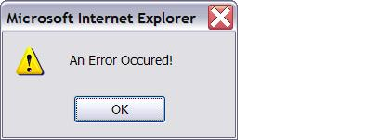
Predefined functions in JavaScript
DialogBoxes
  alert( message)
  Displays an alert box with a message defined by the string message.
  Eg.
  alert(“”An Error Occurred!”)
HTM JavaScript - Day-2

Slide 107
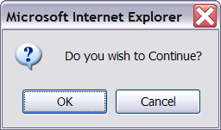
Predefined functions in JavaScript (contd.)
confirm(message)
  When called, it will display the message and two boxes. One box is "OK" and the other is "Cancel". If OK is selected, a value of true is returned, otherwise a value of false is returned.
  Eg.
  confirm(“Do you wish to Continue?”)
HTM JavaScript - Day-2

Slide 108
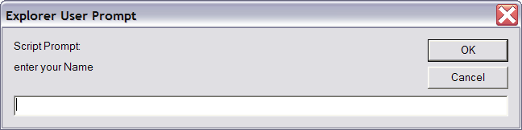
Predefined functions in JavaScript (contd.)
prompt(message)
  Displays a box with the message passed to the function displayed.
  The user can then enter text in the prompt field, and choose OK or Cancel.
  If the user chooses Cancel, a NULL value is returned. If the user chooses OK, the string value entered in the field is returned.
  Eg:
  prompt(“enter your Name”)
HTM JavaScript - Day-2

Slide 109
Predefined functions in JavaScript (contd.)
Conversion Functions
  eval(string)
  Converts a string to an integer or a float value.
  Eg
  x=“20”
  y=eval(x)+10
  y contains the value 30
HTM JavaScript - Day-2
Notes:
Eval()
It can also evaluate expressions included with a string. In the example, value1 becomes 62. value1 = eval("124/2") ,

Slide 110
Predefined functions in JavaScript (contd.)
  isNAN(value)
    If the value passed is not a number then a boolean value of true is returned else the boolean value of false is returned.
    Eg
    x=“Samuel”
    y=isNAN(x)
    The value stored in y is false
HTM JavaScript - Day-2

Slide 111
Predefined functions in JavaScript (contd.)
  parseInt(string)
  Converts a string to an integer returning the first integer encountered which is contained in the string.
  Eg
  x=77AB67
  y=parseInt(x)
  y stores the value 77
HTM JavaScript - Day-2
Notes:
If x=AB77
parseInt(x) will return NAN
If x=67.7hj76
Parseint(x) will return 67 the floating point will not be taken into consideration

Slide 112
Predefined functions in JavaScript (contd.)
  parseFloat(string)
  Converts a string to an float value .
  Eg
  x=77.5AB67
  y=parseFloat(x)
  y stores the value 77.5
HTM JavaScript - Day-2
Notes:
If x=56ABC
parseFloat(x) will return 56
If there are no floating points then the integral value is returned.

Slide 113
User Defined Functions
It is a good practice to define your functions in the head of your program and to call them from anywhere in the body of your program.
Syntax To Define a Function in JavaScript
function name(argument1, argument2,…, argument n)
{
statements , which may include return
}
HTM JavaScript - Day-2

Slide 114
Events & Event Handlers
Event - The change in the state of an object is known as Event.
Event Handler - The code you write to perform an action when the user triggers an event is called an Event Handler
Syntax for calling an Event Handler
<INPUT TYPE=“Object” name=“check” value=“Object name” event = “functionName(param1, param2,…paramN)”>
Example:
<INPUT TYPE=“Button” name=“check” onClick=“validate(this)”>
HTM JavaScript - Day-2

Slide 115
Common Event Handlers (contd.)
onLoad and onUnload
  The onload and onUnload events are triggered when the user enters or leaves the page.
  The onload event is also triggered when the image is loaded.
The showstatus() function will be called when a user enters a page
<body onload=“showStatus()”>
HTM JavaScript - Day-2
Notes:
The onload event is often used to check the visitor's browser type and browser version, and load the proper version of the web page based on the information.
Both the onload and onUnload events are also often used to deal with cookies that should be set when a user enters or leaves a page. For example, you could have a popup asking for the user's name upon his first arrival to your page. The name is then stored in a cookie. Next time the visitor arrives at your page, you could have another popup saying something like: "Welcome John Doe!".

Slide 116
Common Event Handlers (contd.)
onFocus, onBlur and onChange
  The onFocus, onBlur and onChange events are often used in combination with validation of form fields.
The checkEmail() function will be called whenever the user changes the content of the field:
<input type="text" size="30" id="email" onchange="checkEmail()">;
HTM JavaScript - Day-2
Notes:
Can refer to http://w3schools.com/jsref/jsref_events.asp for a complete reference of event handlers

Slide 117
Common Event Handlers (contd.)
onSubmit
  The onSubmit event is used to validate ALL form fields before submitting it.
The checkForm() function will be called when the user clicks the submit button in the form.
<form method="post" action="xxx.htm" onsubmit="return checkForm()">
HTM JavaScript - Day-2

Slide 118
Common Event Handlers (contd.)
onMouseOver and onMouseOut
  onMouseOver and onMouseOut are often used to create "animated" buttons.
An alert box appears when an onMouseOver event is detected:
<a href="http://www.ibm.com" onmouseover="alert('An onMouseOver event’)”> <img src=“ibmlogo.gif" width="100" height="30"> </a>
HTM JavaScript - Day-2

Slide 119
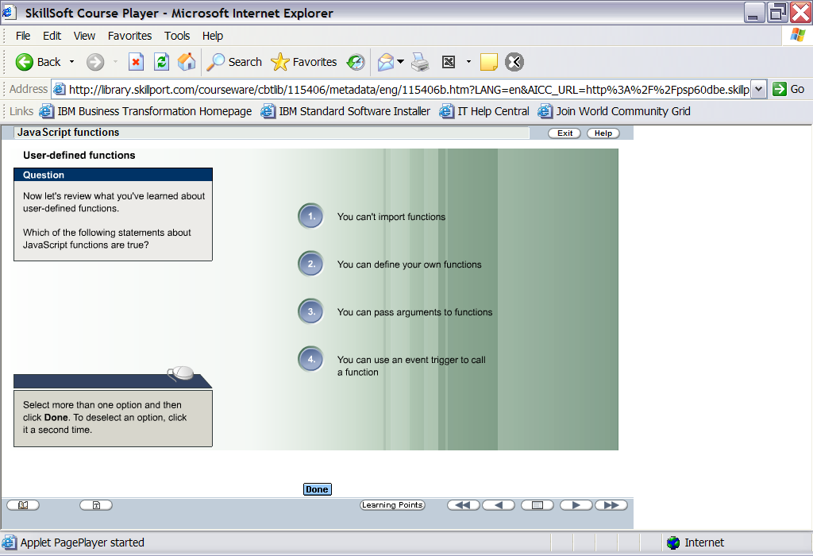
Test Your Understanding
HTM JavaScript - Day-2

Slide 120
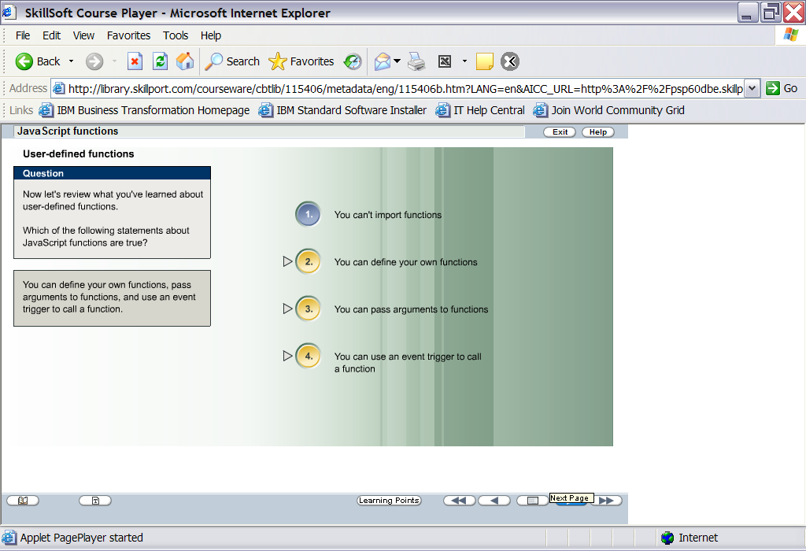
Test Your Understanding
HTM JavaScript - Day-2

Slide 121
A Complete Program
<html>
<head>
<script type="text/javascript">
function myfunction(txt)
{
alert(txt)
}
</script>
</head>
<body>
<form>
<input type="button"
onClick="myfunction('Good Morning!')"
value="In the Morning">
<input type="button"
onClick="myfunction('Good Evening!')"
value="In the Evening">
</form>
<p>
When you click on one of the buttons, a function will be called. The function will alert
the argument that is passed to it.
</p>
</body>
</html>
HTM JavaScript - Day-2

Slide 122
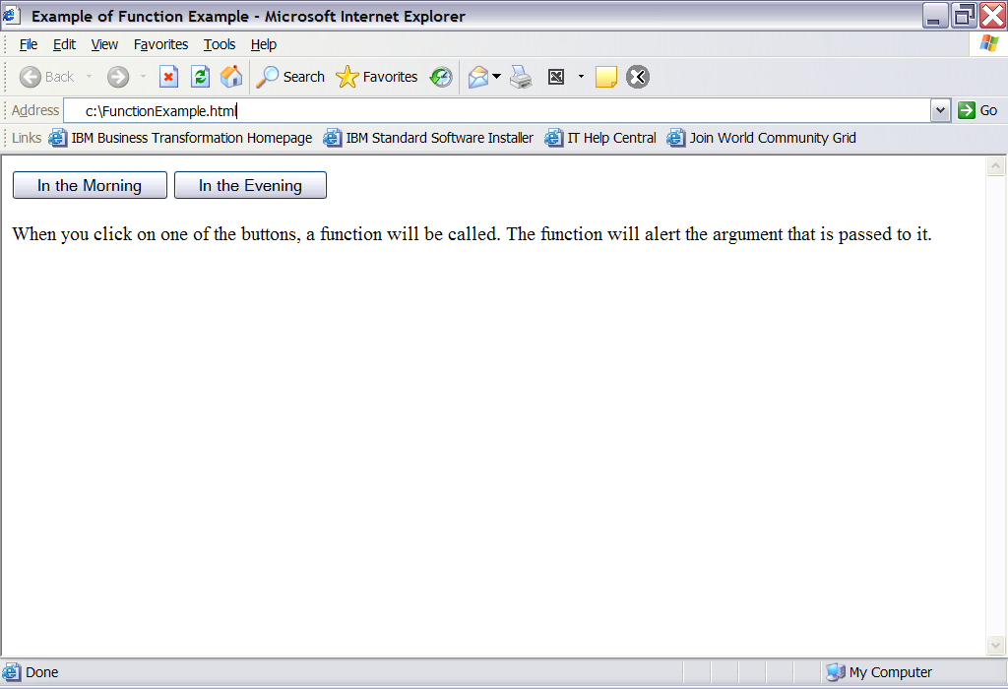
Output
HTM JavaScript - Day-2

Slide 123
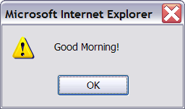
myfunction (txt) receives “ Good Morning!”
HTM JavaScript - Day-2

Slide 124
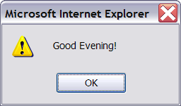
myfunction (txt) receives “ Good Evening !”
HTM JavaScript - Day-2

Slide 125
Special Characters That Can Be Added To Text String
Code | Outputs
\' | single quote
\" | double quote
\& | ampersand
\\ | backslash
\n | new line
\t | tab
\b | backspace
HTM JavaScript - Day-2

Slide 126
Summary (Flow Control)
Flow of the JavaScript can be controlled by
  If…else
  If…else if…else
  switch
  while
  for
  for..in
  continue
  break
HTM JavaScript - Day-2

Slide 127
Summary (Functions)
JavaScript enables you to include user-defined functions in your code.
The syntax of the function statement is shown here.
It is good practice to define your functions in the head of your program and to call them from anywhere in the body of your program.
You can execute a function's statements by calling the function by name.
A function is more than just a block of statements, and you can pass values to your function in the arguments.
HTM JavaScript - Day-2

Slide 128
Summary (Functions contd.)
JavaScript supports a range of event types.
The code you write to perform an action when the user triggers an event is called an event handler.
HTM JavaScript - Day-2

